Slide 1
Access Forms

Slide 2
Access Form
A form allows you to enter/edit/view your data one record at a time in a more convenient layout.
Probably the most common option is to use the Form Wizard
You can also create a form from scratch.

Slide 3
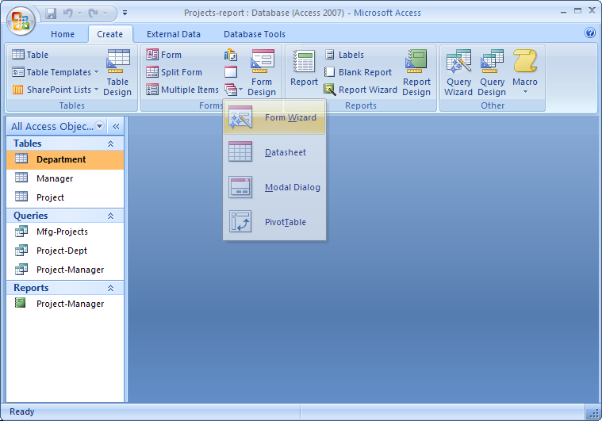
Creating Form starting with Form Wizard

Slide 4
Using Form Wizard
The Form Wizard leads you through a series of choices to help you develop the form based on a table or a query.
Key choices:
  type of layout you want for your form
  style of the form
  name for the form
  table/query to base form
  fields to be included on form
Forms can include a Subform which refers to data in a different table/query that is linked to the base table of the main form
Once a form has been created it can be further refined in Design View

Slide 5
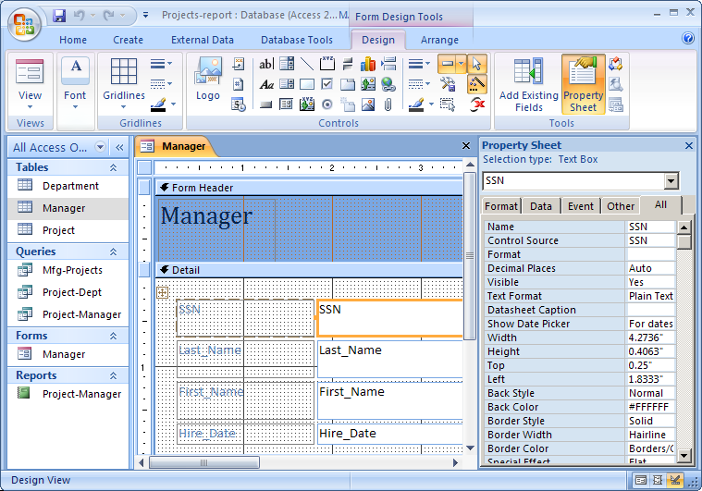
Form Design View

Slide 6
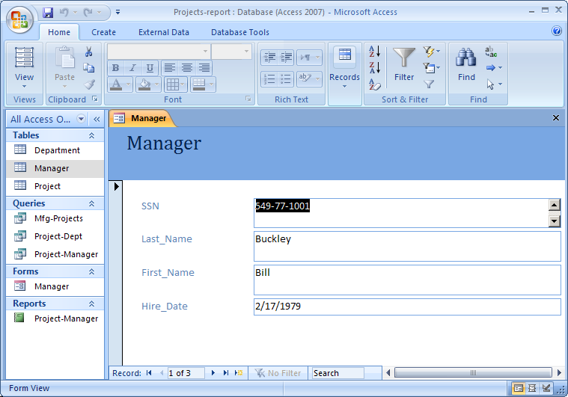
Form in use

Slide 7
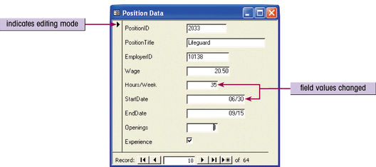
Working with data using Forms
You can view, add, modify, and delete records in forms.
You navigate to the record, then make your changes.
To add a record:
  Click the New Record button on the form view toolbar
  A blank form will appear. Enter the new data values for the new record
When you move off the record, the changes are made directly to the table.

Slide 8
END

